Slide 1
Maths lesson in English
Class 7a

Slide 2
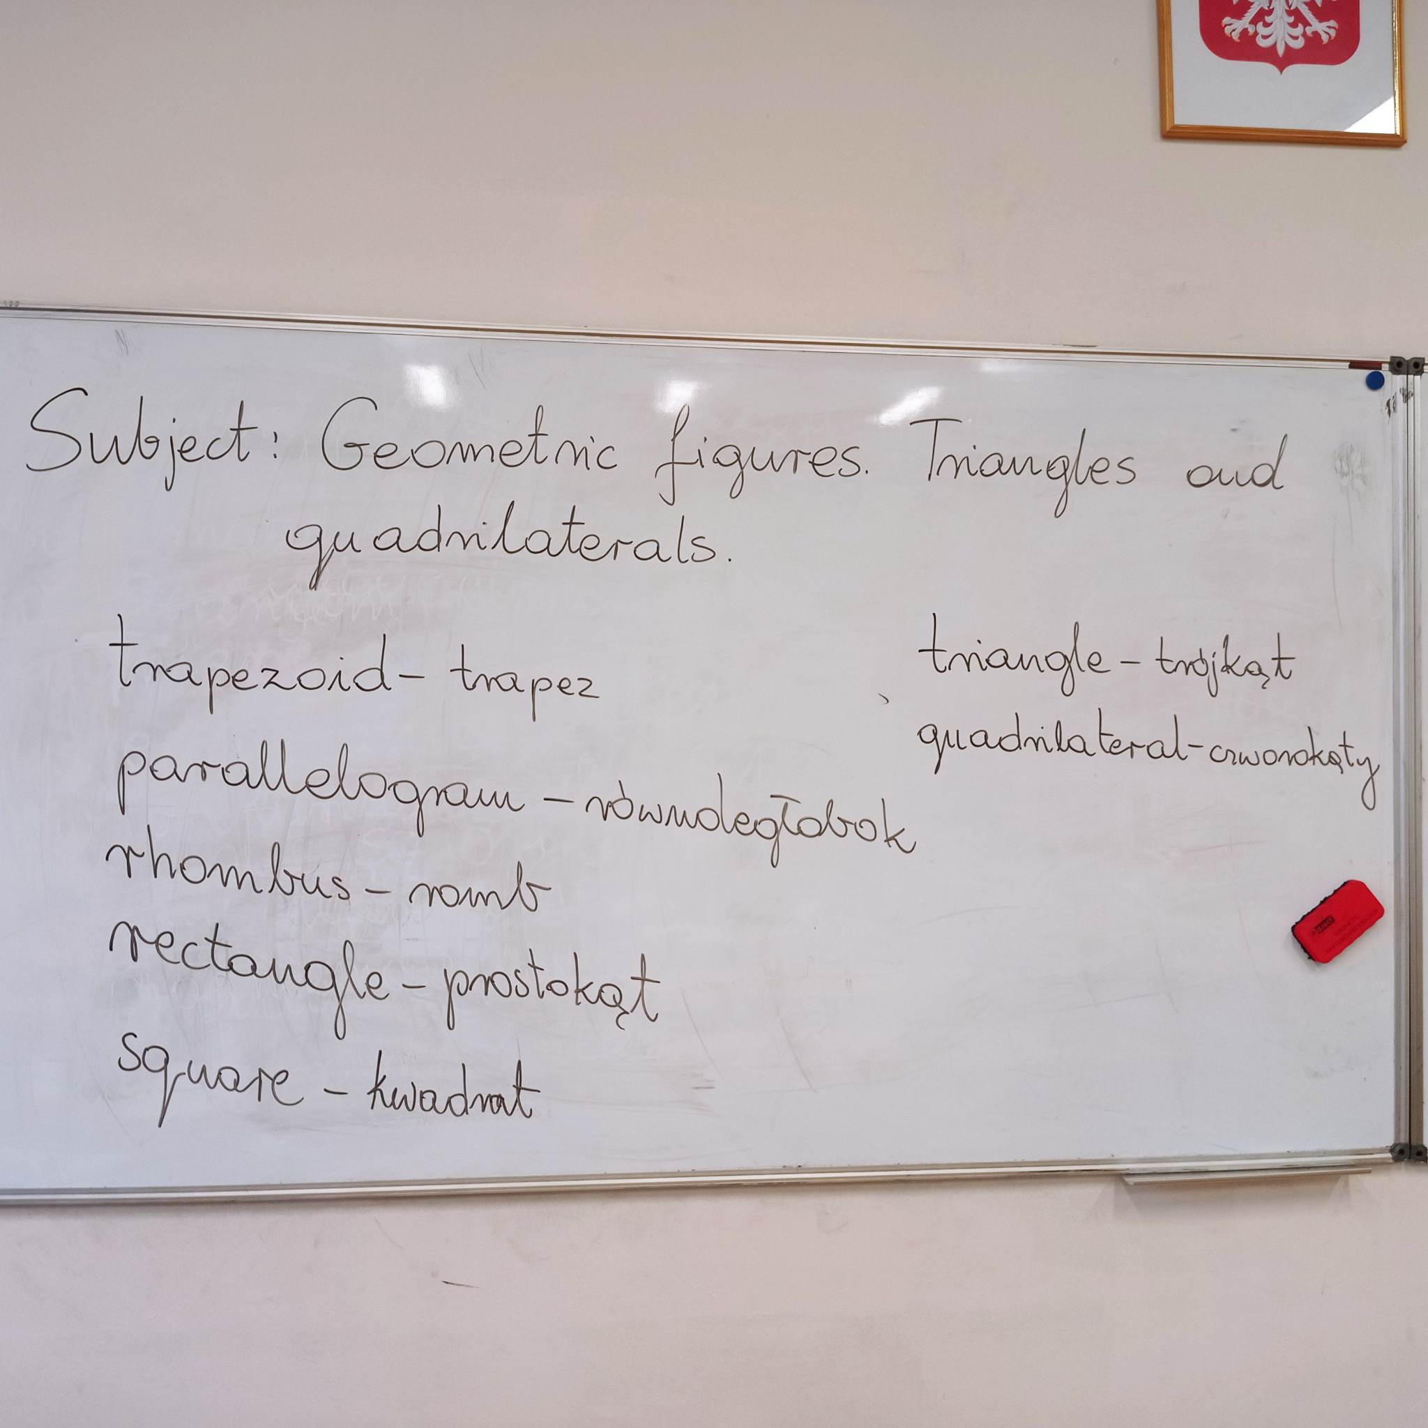
Maths in English
Last Maths lesson of class 7A was in English. The subject of the lesson was: Geometric figures. Triangles and quadrilaterals ( Figury geometryczne. Trójkty i czworokąty)

Slide 3
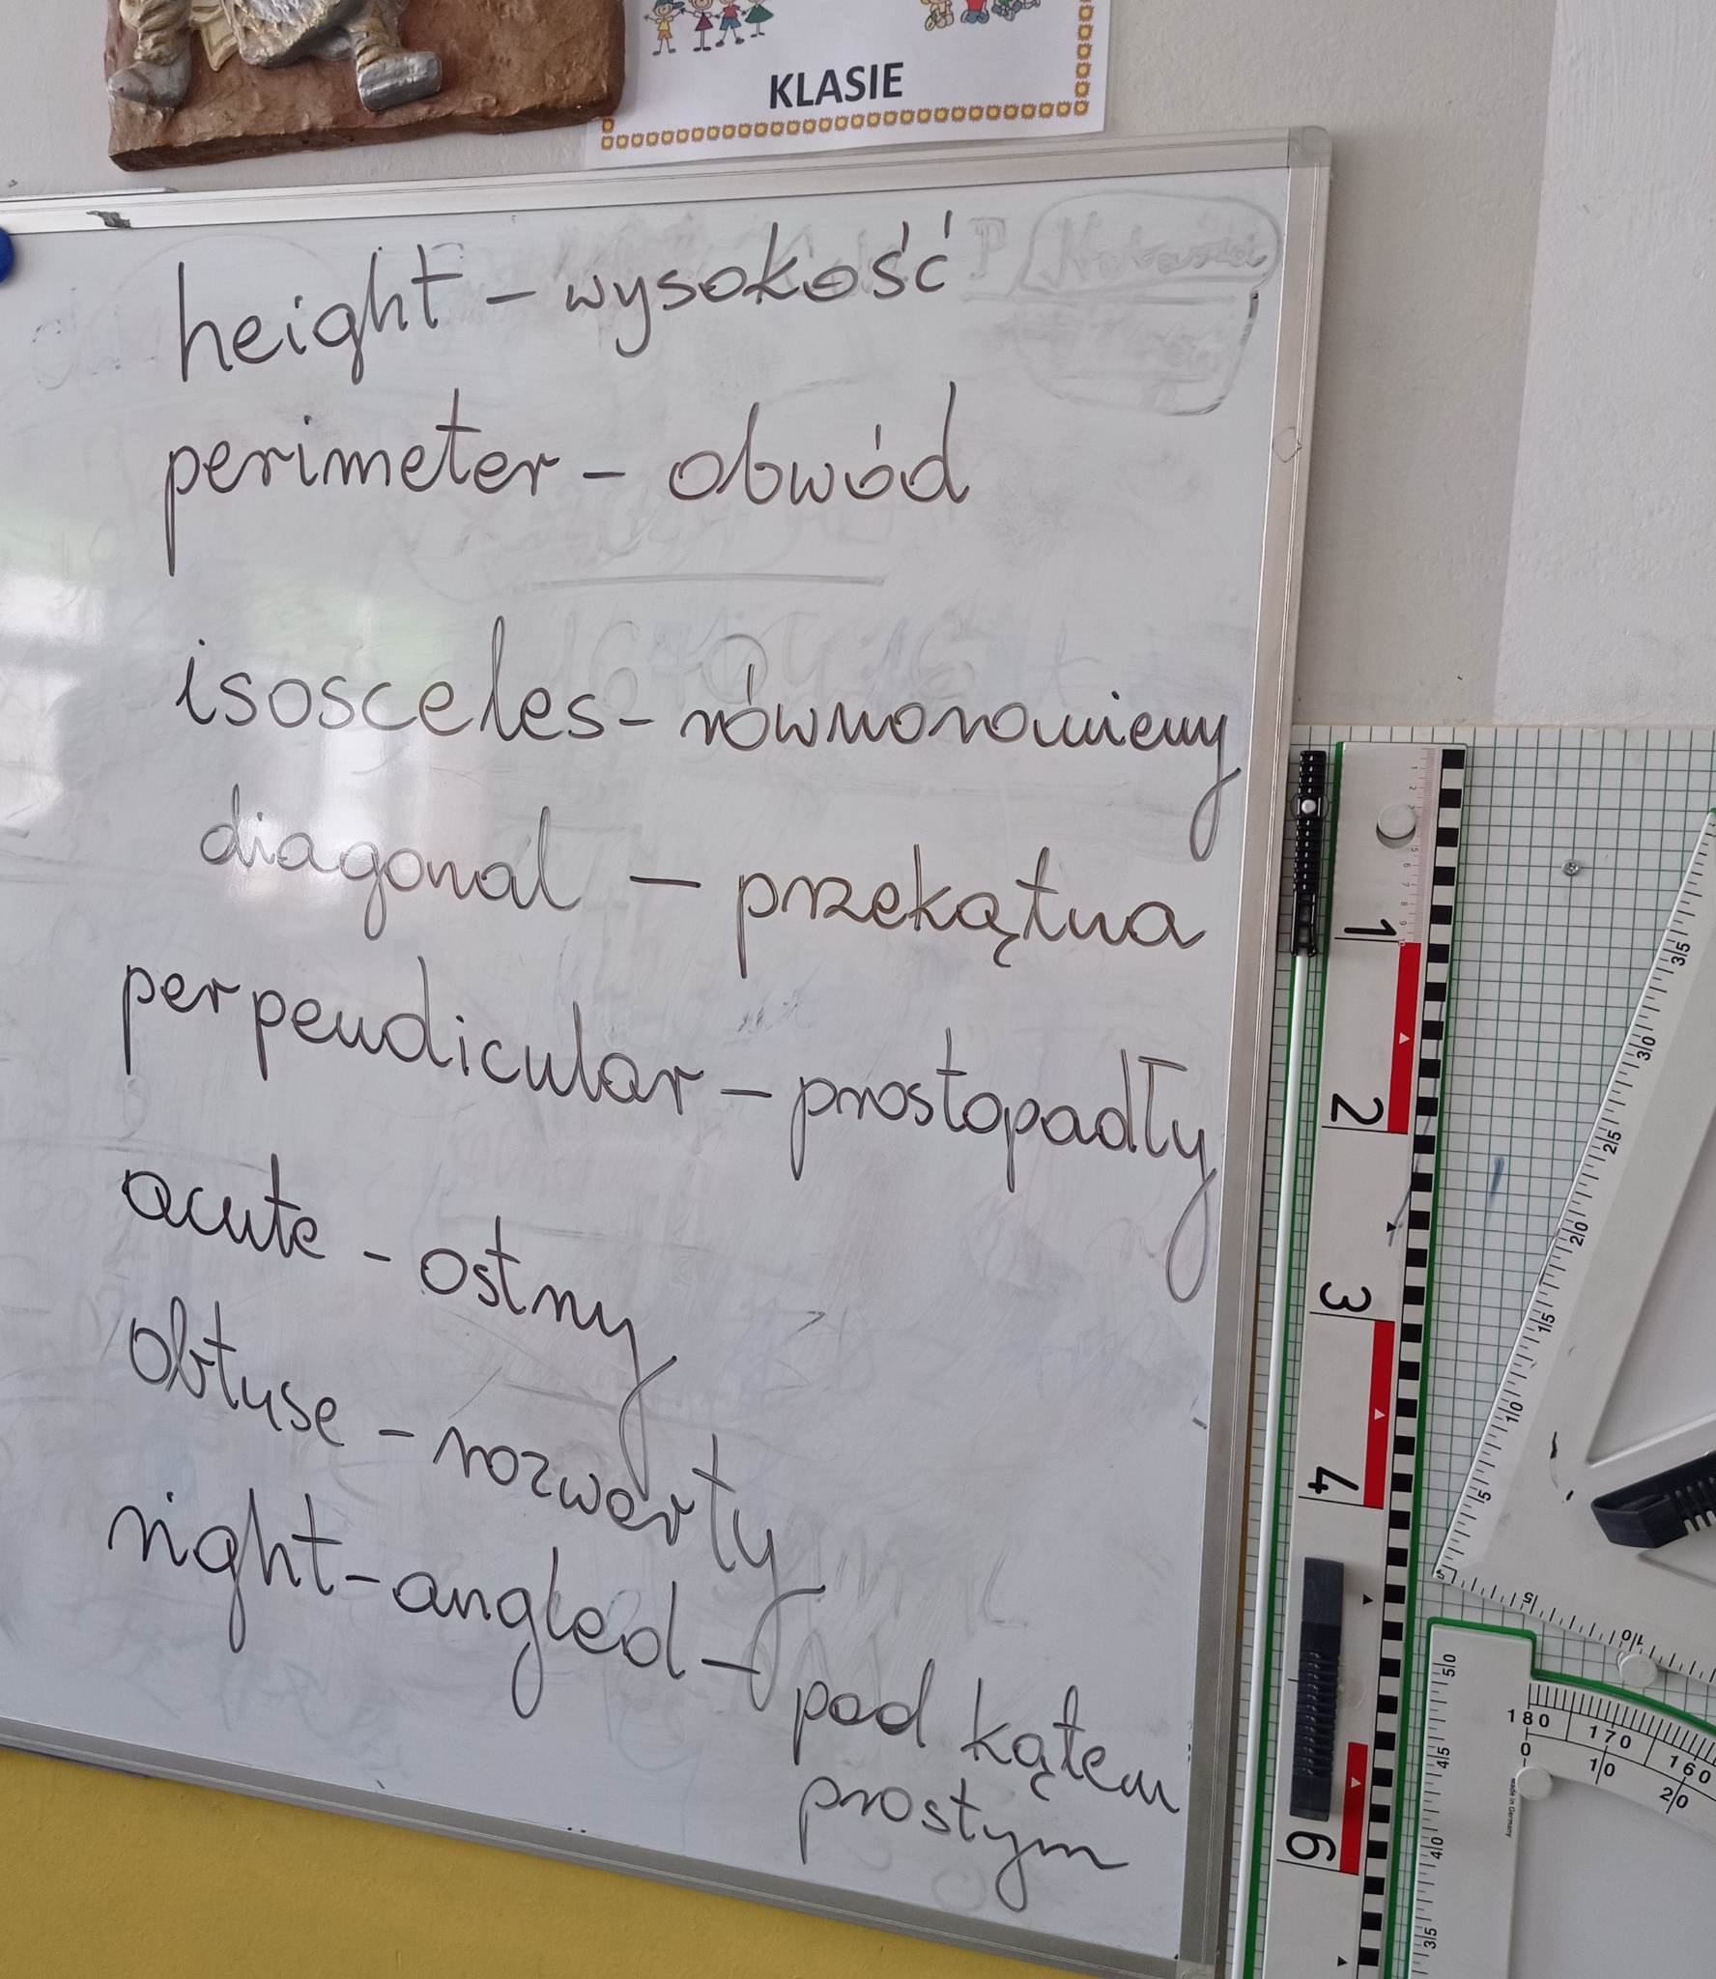
We learned a lot of new words for example: height, diagonal, acute …

Slide 4
… and many others.

Slide 5
Then we were given 8 tasks to solve:

Slide 6
It was a very interesting experience ☺
Special thanks for our Maths teacher: Mrs Monika Polanowska for the lesson.

Slide 7
Thank you for attention. Made by Emilia Delgado Gómez

